Slide 1
Heap Implementation using Arrays = Common Techniques
Question | Summarized Technique
Unsorted by K positions for N integers Fully Sort in O(N) | Create min heap of size K+1 (Log K < Log N) O(K) Extract Min; O(Log K) Add next value in array from K to N;
Check for valid min heap | Check that parent < child; Child at 2i+1 and 2i+2 index; such that the index are within heap length; Check index = 1 to n/2 approximately O(N)
Create Max Heap in O(N) w/o shiftDown for 1 to N | Start from N to 1 in array implementation

Slide 2
AVL TREE
Question | Summarized Technique
Deletion of Keys within a range(I,j) | Insert I if not found in AVL; Call successor; if successor < j; delete(i) and replace I with successor; find new successor of new I;
Unbroken Sequence(1,2,3) (6,7,8) – output 3 | Use AVL Tree to store what is not found – 4,5,etc; Output AVL.searchMin – 1;
Number of Shapes of AVL; | N(H) = 2 * (N(H-1) – N(H-2)); 2* because left or right subtree can be bigger;

Slide 3
Graph Structure
Question | Summarized Technique
Mix of edges; Return Type of graph given unweighted | Store adjList of edges; If (u,v) but not (v,u) – Directed; etc
Finding a starting point that allows u to reach all other points; Must be given there is a starting point; | Topological ordering; return top of stack(which re by DFS according to topoSort(Because it must appear before every other points) Or Counting Component on every point as source; Point with 1 Component strictly in starting point;
 | Tranpose the graph to reverse edges to find which edges point to specific vertex(make adjList); Make new Q to store new Data;
Preprocessing | Usually to make new AdjList or Graph Structure O(V+E) for adjList iteration;
Algorithms;
DFS/BFS
Topological Sort
Bipartite Graph Check(Color)
Cut Vertex and Bridge
Kosaraju / Tarjan for SCC’s
For Graph Modelling;
STATE what the vertices and edges are
Edges – Unweighted/Weighted, Directed/Undirected/Bidirected

Slide 4
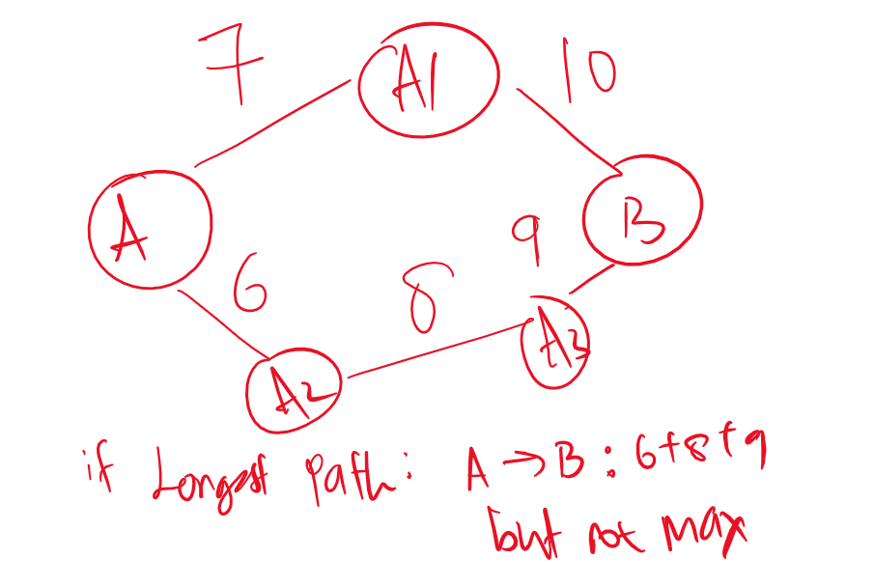
MST
Question | Summarized Technique
Best Valid Path with Maximized Minimum | Run Kruskals(UFDS)/ Prims(BFS + PQ)
Destroyed weakest edge in MST, find next best edge | Should split into 2 components; Run Counting Components; if 1 component; there is an alternative route Else; Label the component they belong to; Loop through AdjList and find next best edge that connects 2 comps;
2 Types of Edges Weight; Find Best MST | Counting Components on the smallest edge only; ignore the other type, if 2 Components found – Implication that one vertex has only edge weight of other type;
Largest Edge in a MiniMax path from Source A to B | Prims Algo from A until it reaches B; Store variable of largest edge;
Remember; SSSP != MST;
Maximized Minimum != Longest Path from A to B;

Slide 5
SSSP
Question | Summarized Technique
Finding Shortest Path with <= K Vertices | Dijkstra with triple PQ <Distance,Hops,Vertex>; Condition on distance, then number of hops;
Colored Path and Shortest Path | Dijkstra PQ on colored paths;
Finding next best route given cant use any of the SSSPs | Double SSSP; SSSP to find the shortest path and remove these edges from the list by making AL’ by checking P array; Run Dijkstra on new AL’
Finding Shortest Path Given need to visit a sequence(A,B,C…) | Running Bellman ford from A to B while not including C… O(KV^3) ; Unoptimized Using a HashMap to check if path should be included; HashMap to store A,B,C,…; Run Dijkstra from A to B, B to C; Remove A and B from HashMap; after Dijkstra; reinsert back, then remove B and C
Remember! SSSP Stores TOTAL DISTANCE FROM A to X
So D[v] > D[u] + Weight; D[v] = D[u] + Weight;

Slide 6
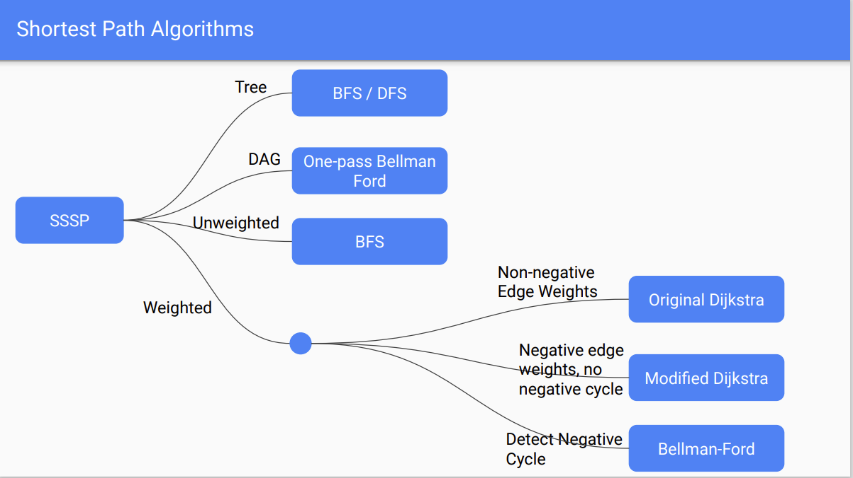
O(V3) for Floyd Warshall – APSP
Or SSSP
Use V-1 Bellman Ford for anything;

